Slide 1
Anvil Project Overview
Dalton A. Brucker-Hahn
Alex Bardas
Drew Davidson

Slide 2
Project Status Overview
Initial service mesh security study (SecureComm ’20)
Submission of ServiceFRESH (Anvil predecessor) in Feb ‘21
Submission of Anvil Feb ’22
Next Steps:
Revise Anvil performance and network algorithms
Improve Anvil ACLs

Slide 3
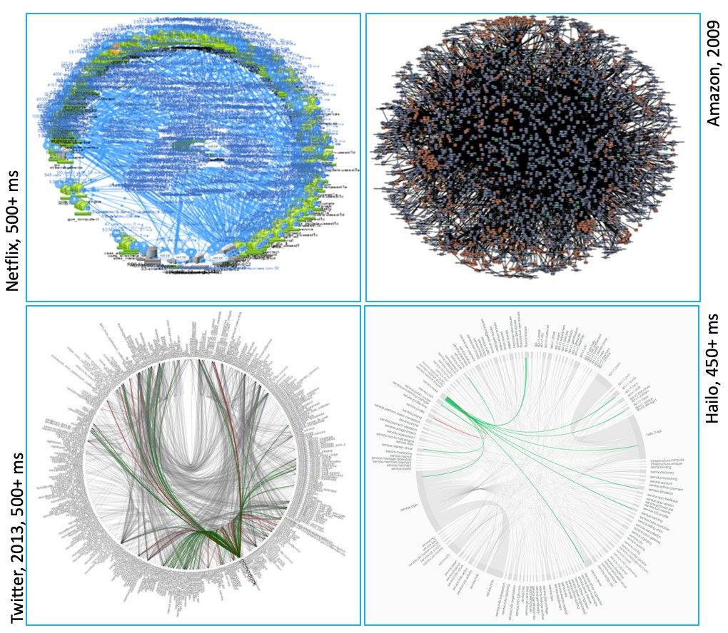
Cloud Computing
“Death Star Maps” -- represent dependencies between microservices

Slide 4

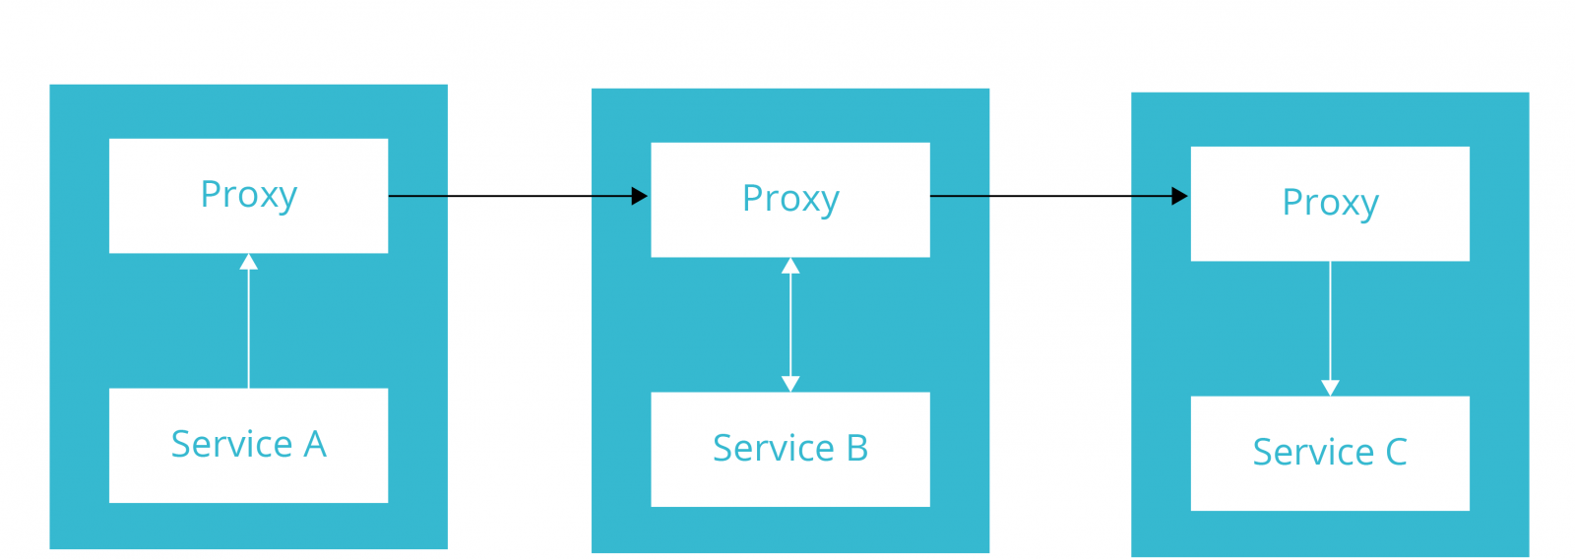
Microservice
Application
Monolithic
Application
Service Mesh Abstraction

Slide 5


Slide 6
(Micro)services
Microservice Application (Employee and Workstation)
Performs an atomic function/operation
Easy to update, maintain, and develop
Deployable as a containerized application, virtual machine, or whole server

Slide 7
Service Meshes
Service Mesh Proxy
(In and Out Dropbox)
Sends and receives messages on behalf of microservice application
Labels messages with correct destination
Applies security features to messages

Slide 8
Microservice Application
Service Mesh Proxy

Slide 9


Alice
Bob

Slide 10
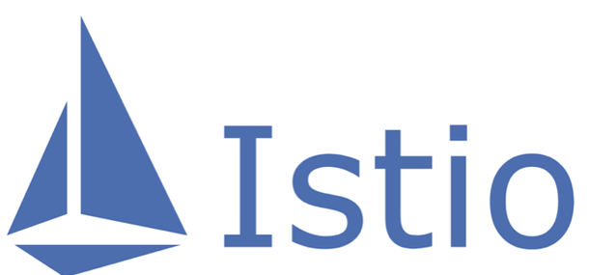





Platform-Independent Service Meshes
Platform-Dependent Service Meshes
Pros
Cons
Pros
Cons
Flexible deployment options
Extremely lightweight
No external expertise required
Default security support limited
Security refreshment requires redeployment
Centralized management
Platform-provided security features
Outsourced functionality*
Limited deployment options
Additional expertise required
Cost of underlying platform included
Outsourced functionality*
Anvil
Flexible deployment options
No external expertise required
Security artifact refreshment
Automatic mTLS
Platform-independent

Slide 11
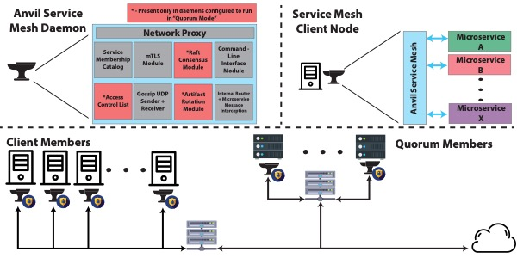
Anvil Overview

Slide 12
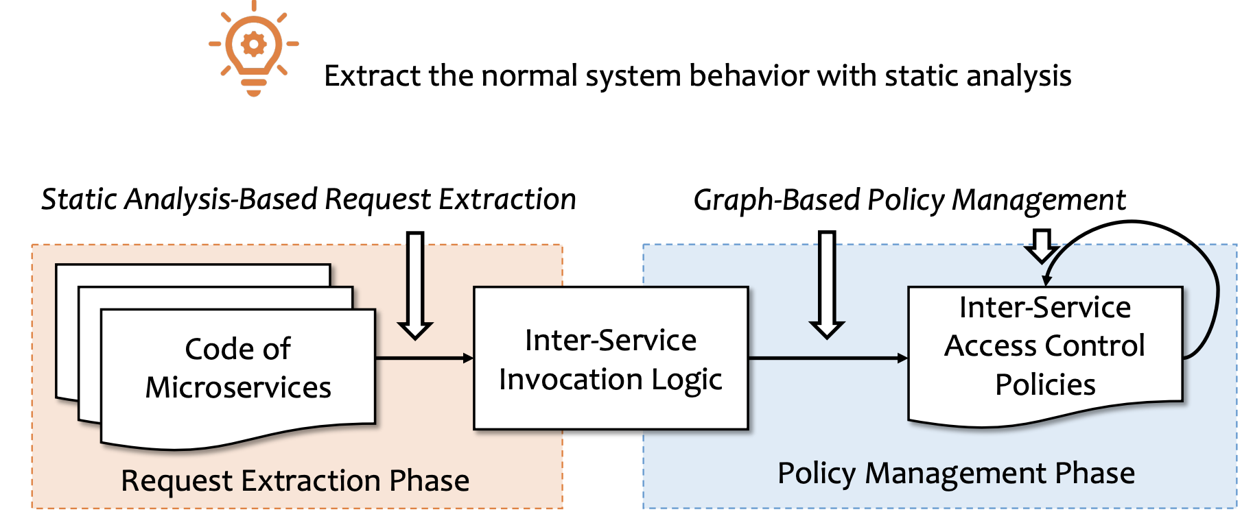
Related Work -- AutoArmor (USENIX ‘21)

Slide 13
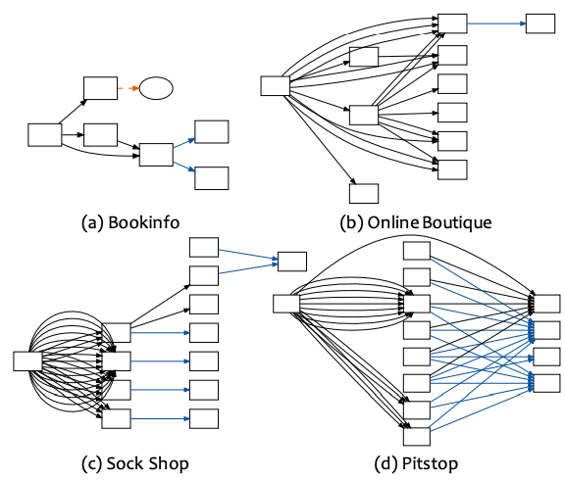

Slide 14
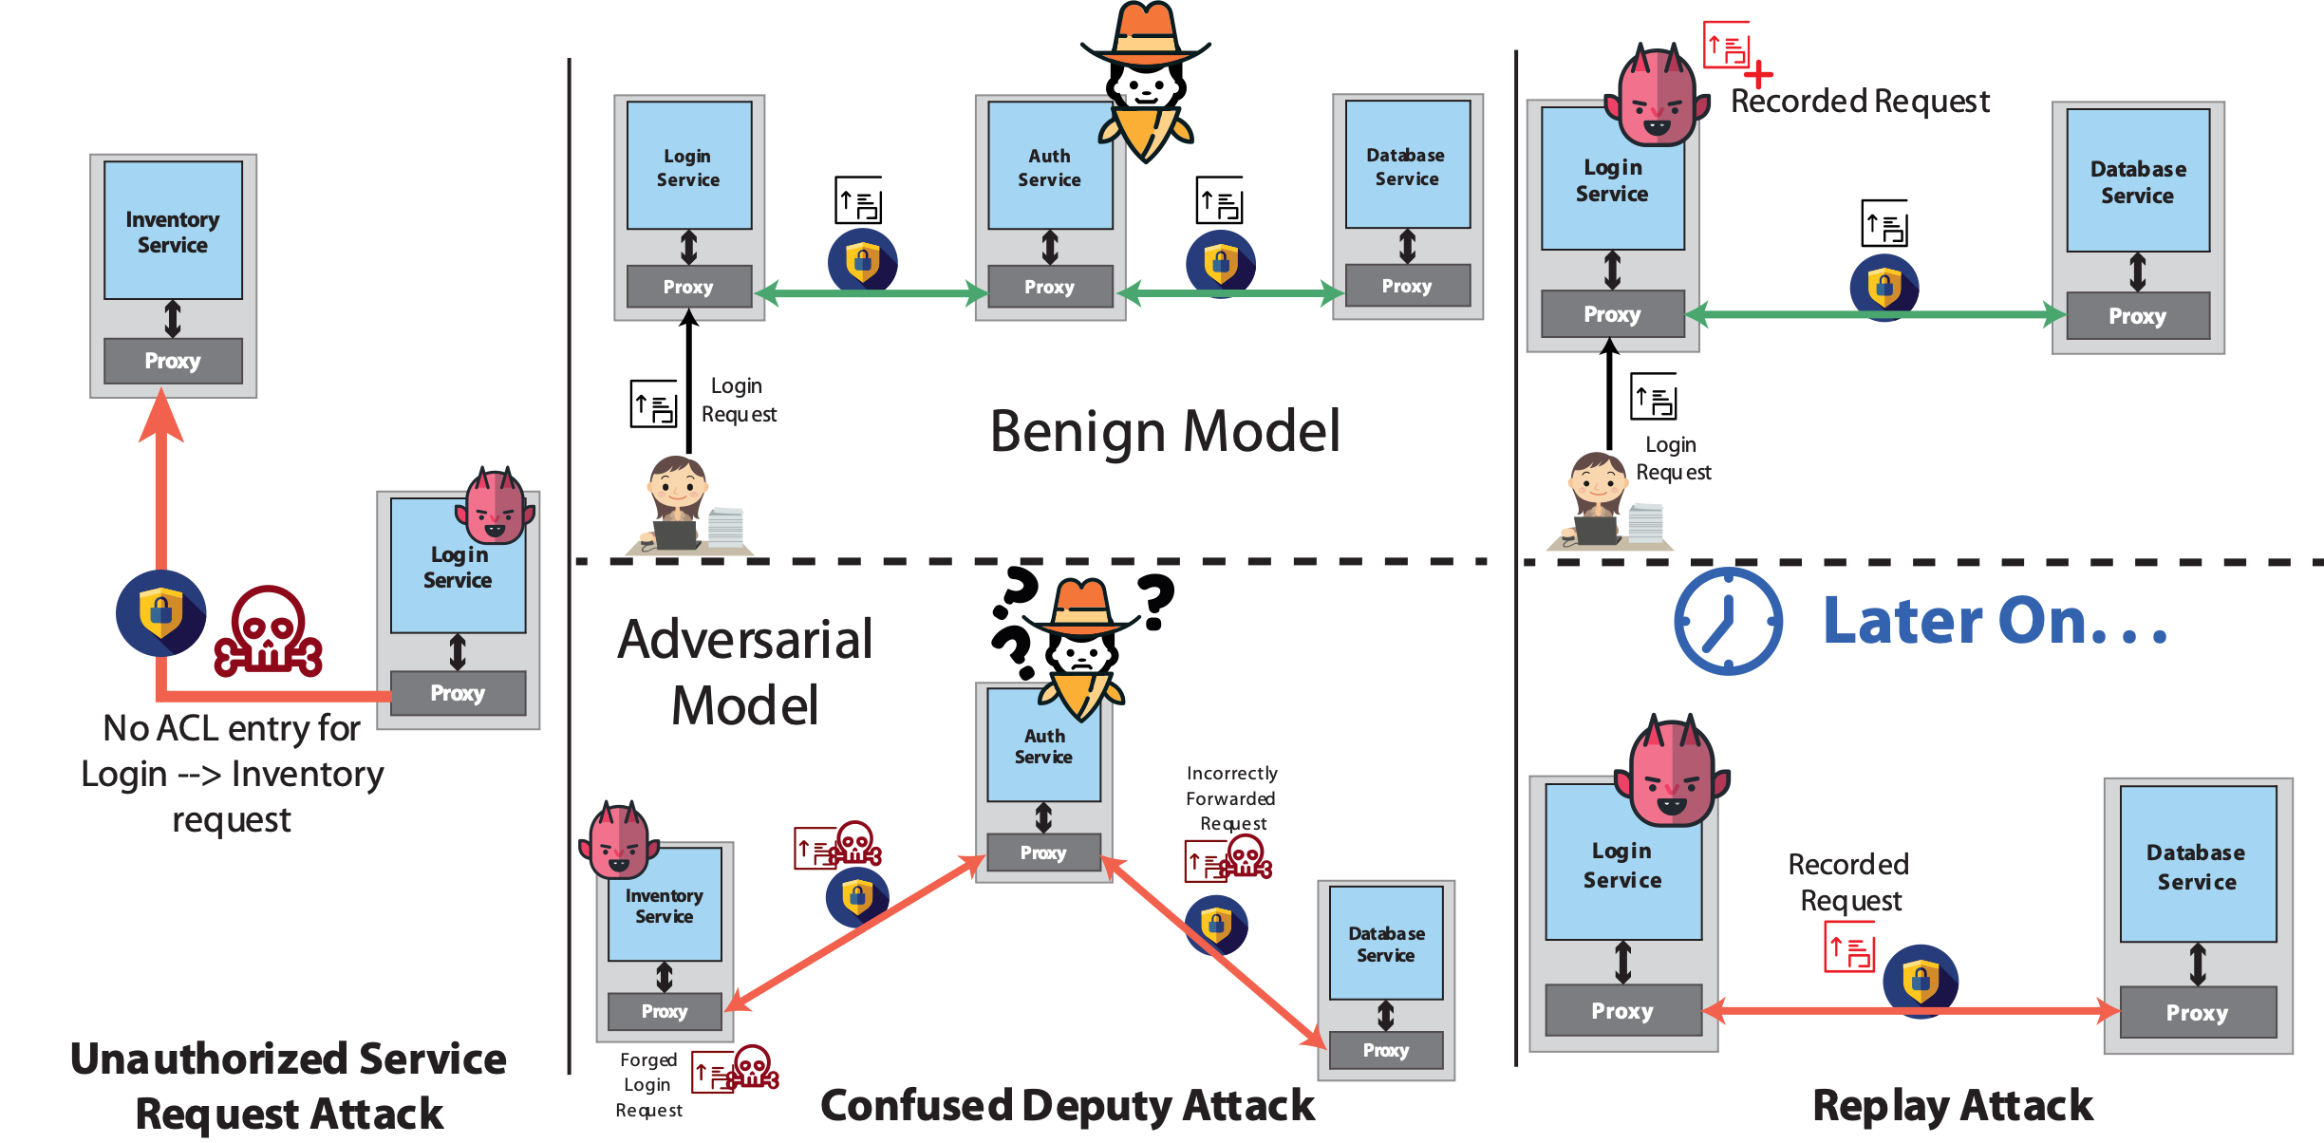
Attack prevented via traditional access control mechanisms in modern service meshes.
Work to automate the process formalized in AutoArmor (USENIX ‘20)

Slide 15
Goal -- introduce a more robust and verbose access control definition that can be enforced by service mesh
Novel threat within the service mesh access control domain

Slide 16
Goal -- introduce a more robust access control verification scheme relevant to service meshes and microservices
Novel threat within the service mesh access control domain

Slide 17
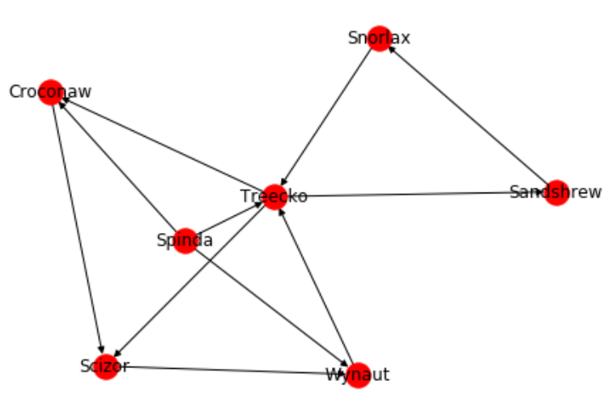
Microservice Deployment Graph Generator

Slide 18
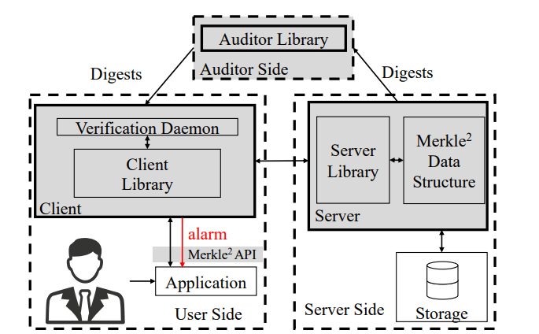

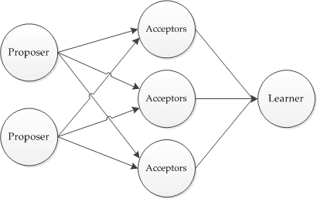
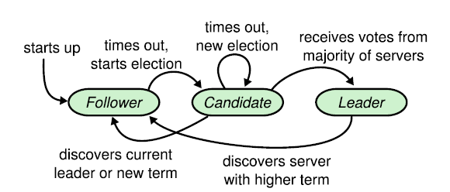
Anvil Platform Improvements
Leveraging Anvil for future research
Paxos State Machine Abstraction
Raft Consensus Algorithm Abstraction
Merkle^2 Transparency Log System Abstraction

Slide 19
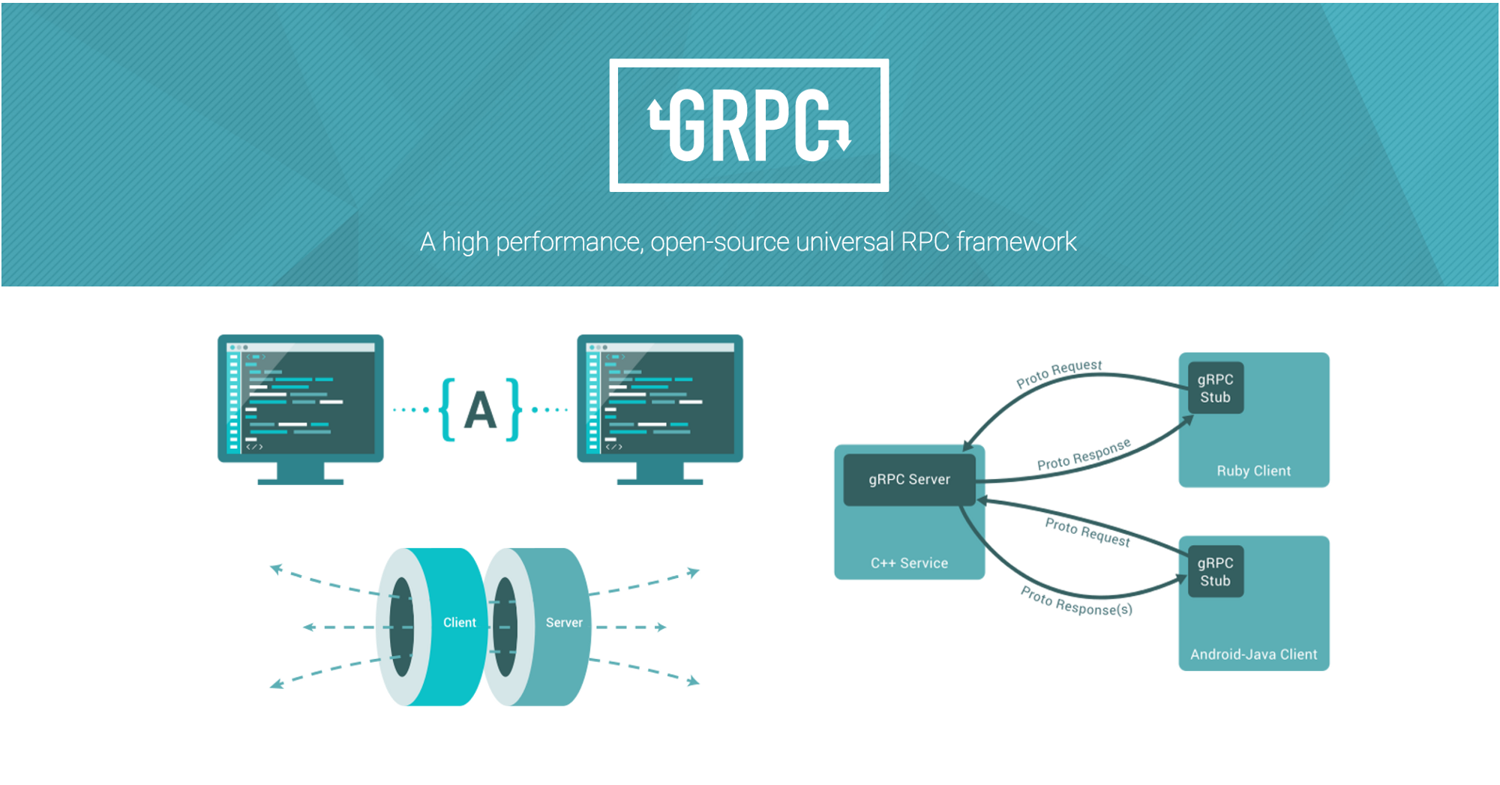
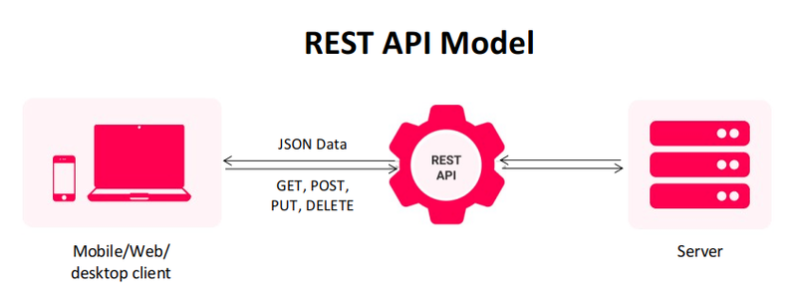
Anvil Platform Improvements
Leveraging Anvil for future research
REST API Communication Model Abstraction
gRPC Communication Model Abstraction

